Slide 1

6. Regression Modelling

Slide 2
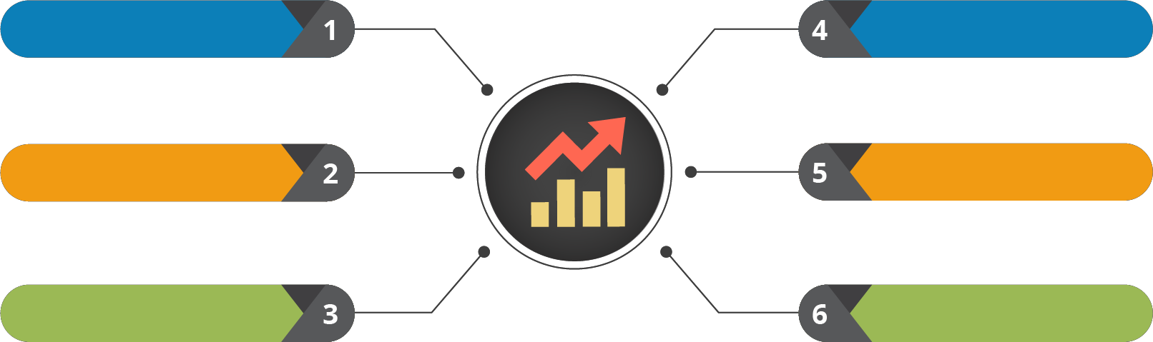
Course Outline
Understanding the Data
Testing the Data
Probability and its Uses
Data Clustering
Statistical Inference
Regression Modelling

Slide 3

Course Objectives
After completing this module, you should be able to:
Express Linear & Logistic Regression Techniques
Express the problem of Collinearity
Describe the concepts and implement WOE and IV
Explore the concepts of Residual Analysis
Define Heteroscedasticity & Homoscedasticity

Slide 4


1. Introduction to Regression

Slide 5

Introduction to Regression

Slide 6





Regression
Study of the relationship between variables
The variable whose dependence is to be studied
Independent
Variable
Affects the change
Dependent Variable
Isolated variable(s) with fixed values

Slide 7



Why Regression?
Model Specification
Determination of which independent variables should be included in or excluded from a regression equation
01
Parameter Estimation
Using sample data, you can estimate the parameters of the selected distribution
02
Prediction
You can predict the future value of your dependent variable using your current data
03

Slide 8
Type of Regression
Primarily, there are two types of regression:
Regression
Linear
Logistic
Simple
Multiple

Slide 9
2. Linear Regression

Slide 10
Linear Regression

Slide 11
Simple Linear Regression
Analyses the relationship between a dependent variable and an independent variable
A mathematical equation represents the relationship
For example: y = c + mx
Independent Variable Parameter to be estimated
Parameter to be estimated Dependent Variable

Slide 12



The Regression Line
Analyses the relation between dependent and independent variable
Dependent Variable
15--
Uses least square estimation to plot the regression line
10--
s
Values of dependent variables lying far away
from line, contain residual values
|
|
|
|
|
|
|
|
-20 -10
10 20 30
Independent Variable
40
50
60
Residual values can be obtained by subtracting
predicted values from actual values
This is the regression line, obtained as a result of linear regression

Slide 13
Simple Linear Regression – Scenario
Following is a sample dataset
‘mtcars_for_manymerge’ containing the variables:
Cars
mpg for Mileage Per Gallon
cyl for cylinder
disp for displacement
hp for horsepower and
drat for real axle ratio
Cars | mpg | cyl | disp | hp | drat
MazdaRX4 | 21 | 6 | 160 | 110 | 3.9
MazdaRX4_WAG | 21 | 6 | 160 | 110 | 3.9
Datsun_710 | 22.8 | 4 | 108 | 93 | 3.85
Hornet_4_Drive | 21.4 | 6 | 258 | 110 | 3.08
Hornet_Sportabout | 18.7 | 8 | 360 | 175 | 3.15
Valiant | 18.1 | 6 | 225 | 105 | 2.76
Duster_360 | 14.3 | 8 | 360 | 245 | 3.21
Merc_240D | 24.4 | 4 | 146.7 | 62 | 3.69
Merc_230 | 22.8 | 4 | 140.8 | 95 | 3.92
Merc_280 | 19.2 | 6 | 167.6 | 123 | 3.92

Slide 14
Simple Linear Regression – Tasks to do
Consider the dataset mtcars_for_manymerge
01
01
Tasks
02
Obtain the regression line between
horsepower and cylinder
02
03
Derive the relation between horsepower and cylinder
03

Slide 15
Step 1: Import Modules
import matplotlib.pyplot as plt
import numpy as np
import pandas as pd
%matplotlib inline

Slide 16
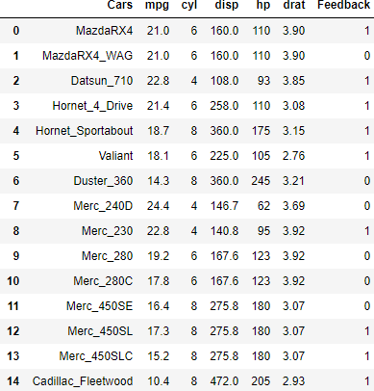

Step 2: Import the Dataset
df = pd.read_csv('mtcars_for_manymerge.csv') df

Slide 17
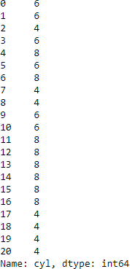
Step 3: Define Dependent and Independent Variable
x = df['hp']
y = df['cyl’] X
y

Slide 18
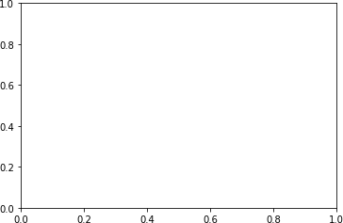
Step 4: Define a Subplot with Axis and Structure
fig, ax = plt.subplots()

Slide 19
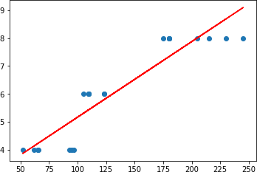
Step 05: Fit a Linear Polynomial with Degree = 1
fit = np.polyfit(x, y, deg=1) ax.plot(x, fit[0] * x + fit[1], color='red')
ax.scatter(x, y)
fig.show()
The Regression line

Slide 20
The Multiple Linear Regression Technique
Analyses the relationship between a dependent variable and multiple independent variables
A mathematical equation represents the relationship
For example: y = 𝑚₁ 𝑥₁ + 𝑚₂ 𝑥₂ +….+ c
Independent Variable
Parameters to be estimated
Independent Variable Parameters to be estimated
Dependent Variable

Slide 21
Multiple Linear Regression – Scenario
Following is a sample dataset of mtcars containing the variables:
Cars
mpg for Mileage Per Gallon
cyl for cylinder
disp for displacement
hp for horsepower and
drat for real axle ratio
Cars | mpg | cyl | disp | hp | drat
MazdaRX4 | 21 | 6 | 160 | 110 | 3.9
MazdaRX4_WAG | 21 | 6 | 160 | 110 | 3.9
Datsun_710 | 22.8 | 4 | 108 | 93 | 3.85
Hornet_4_Drive | 21.4 | 6 | 258 | 110 | 3.08
Hornet_Sportabout | 18.7 | 8 | 360 | 175 | 3.15
Valiant | 18.1 | 6 | 225 | 105 | 2.76
Duster_360 | 14.3 | 8 | 360 | 245 | 3.21
Merc_240D | 24.4 | 4 | 146.7 | 62 | 3.69
Merc_230 | 22.8 | 4 | 140.8 | 95 | 3.92
Merc_280 | 19.2 | 6 | 167.6 | 123 | 3.92

Slide 22
Multiple Linear Regression – Tasks To Do
Consider the dataset mtcars
01
01
Tasks
02
Analyze the regression statistics
between cylinder, mileage and hp
02
03
Derive the relation of cylinder with mileage and hp
03

Slide 23
Step 01: Import the Modules
import | statsmodels.api | as sm
import | numpy as np
import | pandas as pd

Slide 24
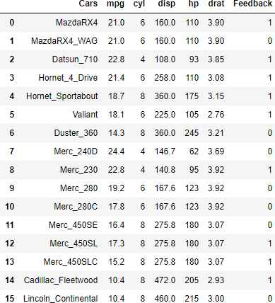
Step 02: Import the Dataset
df = pd.read_csv('mtcars_for_manymerge.csv')
df

Slide 25


Step 03: Define Dependent and Independent Variables
y = df['cyl']
x = df[['mpg','hp']] x
y = df['cyl']
x = df[['mpg','hp’]] y

Slide 26
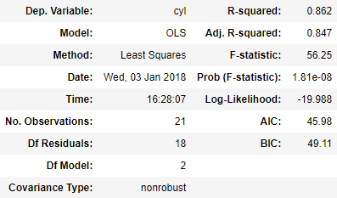


Step 04: Fit a Linear Regression Model
y = df['cyl']
x = df[['mpg','hp']] x = sm.add_constant(x)
model = sm.OLS(y, x).fit()
model.summary()
Note: P value > 0.05 means, the variable is insignificant for this model

Slide 27
3. Logistic Regression

Slide 28
Logistic Regression

Slide 29

There might be a case, where the independent variables are interdependent on each other. As a result of which, the dependent variable may misbehave. The Logistic Regression solves the problem for this

Slide 30

Logistic Regression Technique
The dependent variable is always binary, while
performing logistic regression
Logistic regression model is also called a logit model
A logit can be expressed as log ^{𝑝}ൗ_{1−𝑝} , where p is the probability of occurrence of dependent variable and 1-p is the probability of non- occurrence of dependent variable
Logistic Regression
Different parameters are estimated in order to obtain logit for the dependent variable

Slide 31
Logistic Regression – Scenario
Following is a sample dataset of feedback_mtcars containing the variables:
Cars
mpg for Mileage Per Gallon
cyl for cylinder
disp for displacement
hp for horsepower and
drat for real axle ratio
Feedback for reviews by customers
Cars | mpg | cyl | disp | hp | drat | Feedback
MazdaRX4 | 21 | 6 | 160 | 110 | 3.9 | 1
MazdaRX4_WAG | 21 | 6 | 160 | 110 | 3.9 | 0
Datsun_710 | 22.8 | 4 | 108 | 93 | 3.85 | 1
Hornet_4_Drive | 21.4 | 6 | 258 | 110 | 3.08 | 1
Hornet_Sportabout | 18.7 | 8 | 360 | 175 | 3.15 | 1
Valiant | 18.1 | 6 | 225 | 105 | 2.76 | 1
Duster_360 | 14.3 | 8 | 360 | 245 | 3.21 | 0
Merc_240D | 24.4 | 4 | 146.7 | 62 | 3.69 | 0
Merc_230 | 22.8 | 4 | 140.8 | 95 | 3.92 | 1
Merc_280 | 19.2 | 6 | 167.6 | 123 | 3.92 | 0

Slide 32



Logistic Regression – Tasks To Do
Consider the dataset feedback_mtcars
01
02
Estimate the parameters for all the cars, considering feedback as the dependent variable
03
Formulate a logit equation including all the parameters

Slide 33
Step 01: Import the Modules
import pandas as pd
import statsmodels.formula.api as sm

Slide 34
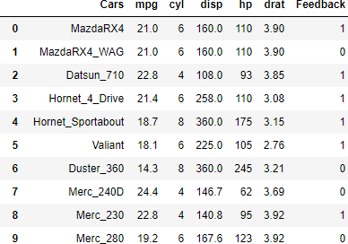
Step 02: Import the Dataset
df = pd.read_csv('feedback_mtcars.csv') df

Slide 35

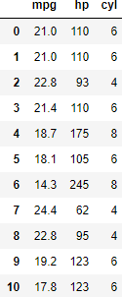
Step 03: Define Dependent and Independent Variables
y = df['Feedback']
x = df[['mpg','hp', 'cyl’]] y
y = df['Feedback']
x = df[['mpg','hp', 'cyl’]] x

Slide 36

Step 04: Fit the Logit Model
model = sm.Logit(y, x)
result = model.fit()

Slide 37
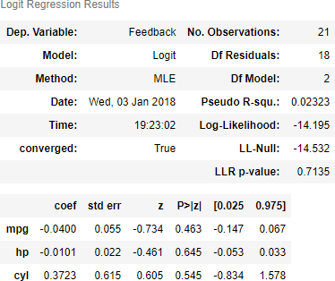
Step 05: Estimate Logit Equation
result.summary()
P values > 0.05 means: ‘mpg’, ‘hp’, ‘cyl’ are not significant enough to
reject null hypothesis w.r.t
‘feedback’

Slide 38
4. Weight of Evidence

Slide 39
Weight of Evidence

Slide 40
Sometimes, a model misspecification may occur, if the independent variable has extraordinarily poor distribution. Hence, WOE technique is used instead of categorical variables

Slide 41


Weight of Evidence (WOE)
The weight of evidence tells the predictive power of an independent variable in relation to the dependent variable
Calculated with the following expression:
% 𝑜𝑓 𝑛𝑜𝑛 − 𝑒𝑣𝑒𝑛𝑡𝑠
WOE = ln
Independent
% 𝑜𝑓 𝑒𝑣𝑒𝑛𝑡𝑠
Variable 2
Independent Variable 1
Note: WOE displays a linear relationship with the natural logarithm of the odds ratio, which is the
dependent variable in logistic regression

Slide 42






Steps for Calculating WOE
Step 01
Splitting the data such that it contains around 5% of the total observation
Step 02
Calculate the number of events and non – events in each group
Step 03
Calculate the
% of events and % of non – events in each group
Step 04
Calculate the natural log of division of % non- events and
% of events

Slide 43
WOE – Scenario
You are having a dataset ‘rating’ with the following variables:
Age: Comprises of age of the customers
Good/Bad: Rating given to the customers based on their behaviour
Age | Good / Bad
24 | 1
25 | 0
28 | 0
32 | 0
34 | 1
24 | 0
33 | 0
34 | 0
26 | 1
21 | 1

Slide 44
WOE – Tasks To Do
Calculate the WOE of age variable such that it forms a linear relationship with logit plot (logistic regression)
Consider the dataset rating
1
2

Slide 45
WOE – Solution
Age group | Bads | Goods | Total | Bad% | Good% | Age_WOE
< = 25 | 2 | 3 | 5 | 0.5 | 0.375 | -0.12494
25 - 30 | 1 | 2 | 3 | 0.5 | 0.25 | 0
> 30 | 1 | 3 | 4 | 0.25 | 0.375 | 0.176091
Total | 4 | 8 | 12
This ‘age_woe’ variable is a standardized variable and can be plotted against the logit value to obtain a linear
curve

Slide 46
5. Information Value

Slide 47
Information Value

Slide 48
The WOE value is also used to calculate the Information Value which is an important parameter to check, if the independent variable is worth (logistic regression procedure)

Slide 49

Information Value (IV)
Compares the predictive power of variables
Technically, it is the sum of absolute values for WOE over all groups
Expressed as: IV = σ % 𝑜𝑓 𝑛𝑜𝑛 𝑒𝑣𝑒𝑛𝑡𝑠 − % 𝑜𝑓 𝑒𝑣𝑒𝑛𝑡𝑠 * WOE
Restricted Information Value
Respected Information Value

Slide 50
The IV Table
Information Value
Variable Predictiveness
Less than 0.02
Not useful for prediction
0.02 to 0.1
Weak predictive power
0.1 to 0.3
Medium Predictive Power
0.3 to 0.5
Strong Predictive Power
>0.5
Suspicious Predictive Power
Note: Information Value increases as bins/groups increases for an independent variable

Slide 51
IV – Scenario
You are having a dataset ‘rating’ with the following variables:
Age: Comprises of age of the customers
Good/Bad: Rating given to the customers based on their behaviour
Age | Good / Bad
24 | 1
25 | 0
28 | 0
32 | 0
34 | 1
24 | 0
33 | 0
34 | 0
26 | 1
21 | 1

Slide 52
IV – Task To Do
Calculate the information value for age to know its predictive power against logistic regression
Consider the dataset rating
1
2

Slide 53
IV – Solution
Age group | Bads | Goods | Total | Bad% | Good% | Avg_WOE | IV
< = 25 | 2 | 3 | 5 | 0.5 | 0.375 | -0.12494 | 0.045927
25 - 30 | 1 | 2 | 3 | 0.5 | 0.25 | 0 | 0.004846
> 30 | 1 | 3 | 4 | 0.25 | 0.375 | 0.176091 | 0.047775
Total | 4 | 8 | 12 |  |  |  | 0.098348
Based on the above calculation and comparing the cumulative IV value with the chart, the ‘age’ variable has
weak predictive power

Slide 54
6. Relevant Variables

Slide 55
Relevant Variables

Slide 56
Now, you know which are the least relevant variables. But, there are methods to calculate which are the most relevant variables. Let’s have a look over them

Slide 57


Likelihood and Probability
Probability
Reality model population
Data Sample
Likelihood
Likelihood function is defined as L: L(𝜃 | 𝑥_{𝑖}) = 𝜋f(𝑥_{𝑖} | 𝜃)
Likelihood of the true parameters being a certain value is the same as the Probability of observing the data

Slide 58
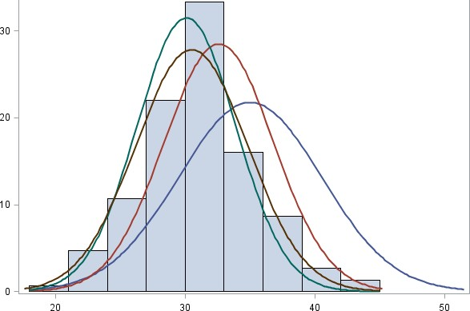
Maximum Likelihood Estimation (MLE)
An idea of working out the most likely cause of an observed result
Considers the likelihood of each of several possible causes and pick the cause with the highest likelihood
Such that if those highest likelihood parameter(s) are used, the observed output values are met

Slide 59

MLE – Scenario
Consider, you have a bunch of coins
Goal: Develop a logistic regression equation with outputs (0 for heads and 1 for tails) such the coefficients calculated always give the observed outcomes (heads or tails)

Slide 60
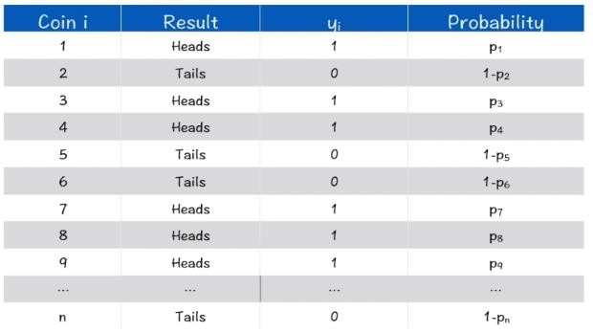
MLE – Experiment
An experiment was performed with i number of coins where heads are denoted as 1 and tails as 0

Slide 61
Defining Likelihood
Likelihood = P(the coin tosses having the given outcomes)

Slide 62
Calculating Likelihood
Since, the heads/tails from each and every coins are independent of each
other, you can say that the events are disjoint events
Calculating Likelihood: (p1) * (1-p2) * (p3) * (p4) * (1-p5) * ….*(1-pn)
Outcome of coin i = 𝑝_{𝑖} 𝑦_{𝑖} (1− 𝑝_{𝑖})^{1−𝑦𝑖}
Likelihood = ς^{𝑛}
𝑖=1
𝑝_{𝑖} 𝑦_{𝑖} (1− 𝑝_{𝑖})^{1−𝑦𝑖}

Slide 63



Maximizing Likelihood
The likelihood is maximized, such that the coefficients predicted, when used give accurate
outcomes
Likelihood = ς^{𝑛} 𝑝_{𝑖} 𝑦_{𝑖} (1− 𝑝_{𝑖})^{1−𝑦𝑖}
𝑖=1
L O G
Log Likelihood = σ^{𝑛} [𝑦_{𝑖}ln 𝑝_{𝑖} + (1− 𝑦_{𝑖} )ln(1− 𝑝_{𝑖})]
𝑖=1
Note: Since, its difficult to maximize a product, so log of product taken in order to convert it to sum

Slide 64
The Likelihood Parameter with Python
Recall the python output, where you estimated for the Logit equation

Slide 65
7. Residual Analysis

Slide 66
Residual Analysis

Slide 67
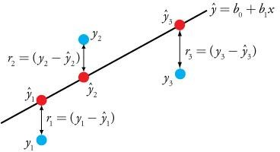
Residual Analysis
When you perform simple linear regression (or other type of regression analysis), you get a line of best fit
The data points usually don’t fall exactly on this regression
equation line
The vertical distance between a data point and the regression line is termed as Residual
Residual is positive, if the data points are above regression line
Negative, if they are below the regression line
Zero residual is obtained, if the regression line passes through the data point

Slide 68
Residuals
Difference between the observed value of the dependent value (say y) and the predicted value (say 𝑦ො) is called the Residual
Expressed as: Residual (e) = Observed value (y) – Predicted Value (𝑦ො)
Sum and mean of the residual is equal to 0, σ 𝑒 = 0

Slide 69



Residual Plots
A linear model is chosen: If the points in a residual plot are randomly dispersed around the horizontal axis
A non – linear model is chosen: If the points in a residual plot are systematically distributed
Best fit for linear model
Best fit for non-linear model
Best fit for non-linear model

Slide 70
7. Heteroscedasticity & Homoscedasticity

Slide 71
Heteroscedasticity & Homoscedasticity

Slide 72
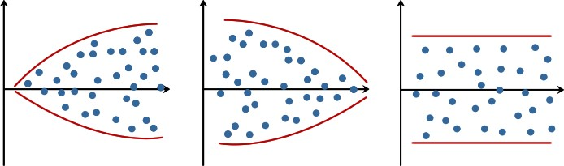
Heteroscedasticity & Homoscedasticity
A Situation in which the errors have constant variance, the errors are called Homoscedastic
Heteroscedasticity, on the other hand is violation of Homoscedasticity
Technically, Heteroscedasticity is the change in variance of the errors across observations
Heteroscedasticity
Heteroscedasticity
Homoscedasticity

Slide 73

Summary
In this module, you should have learnt:
Linear & Logistic Regression
Multicollinearity
WOE & IV
Maximum Likelihood Estimation
Residual Analysis
Heteroscedasticity

Slide 74


Congratulation
Probability & Statistics
for Data Science
You have successfully completed –
Regression Modelling Session

Slide 75





Next, You will be the Master in
Foundations of Data Science
Okay, I clearly understand the Regression Modelling
What Next?

Slide 76



Slide 77


Slide 78


Slide 79


